Slide 1


Slide 2


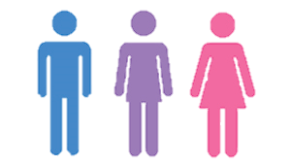
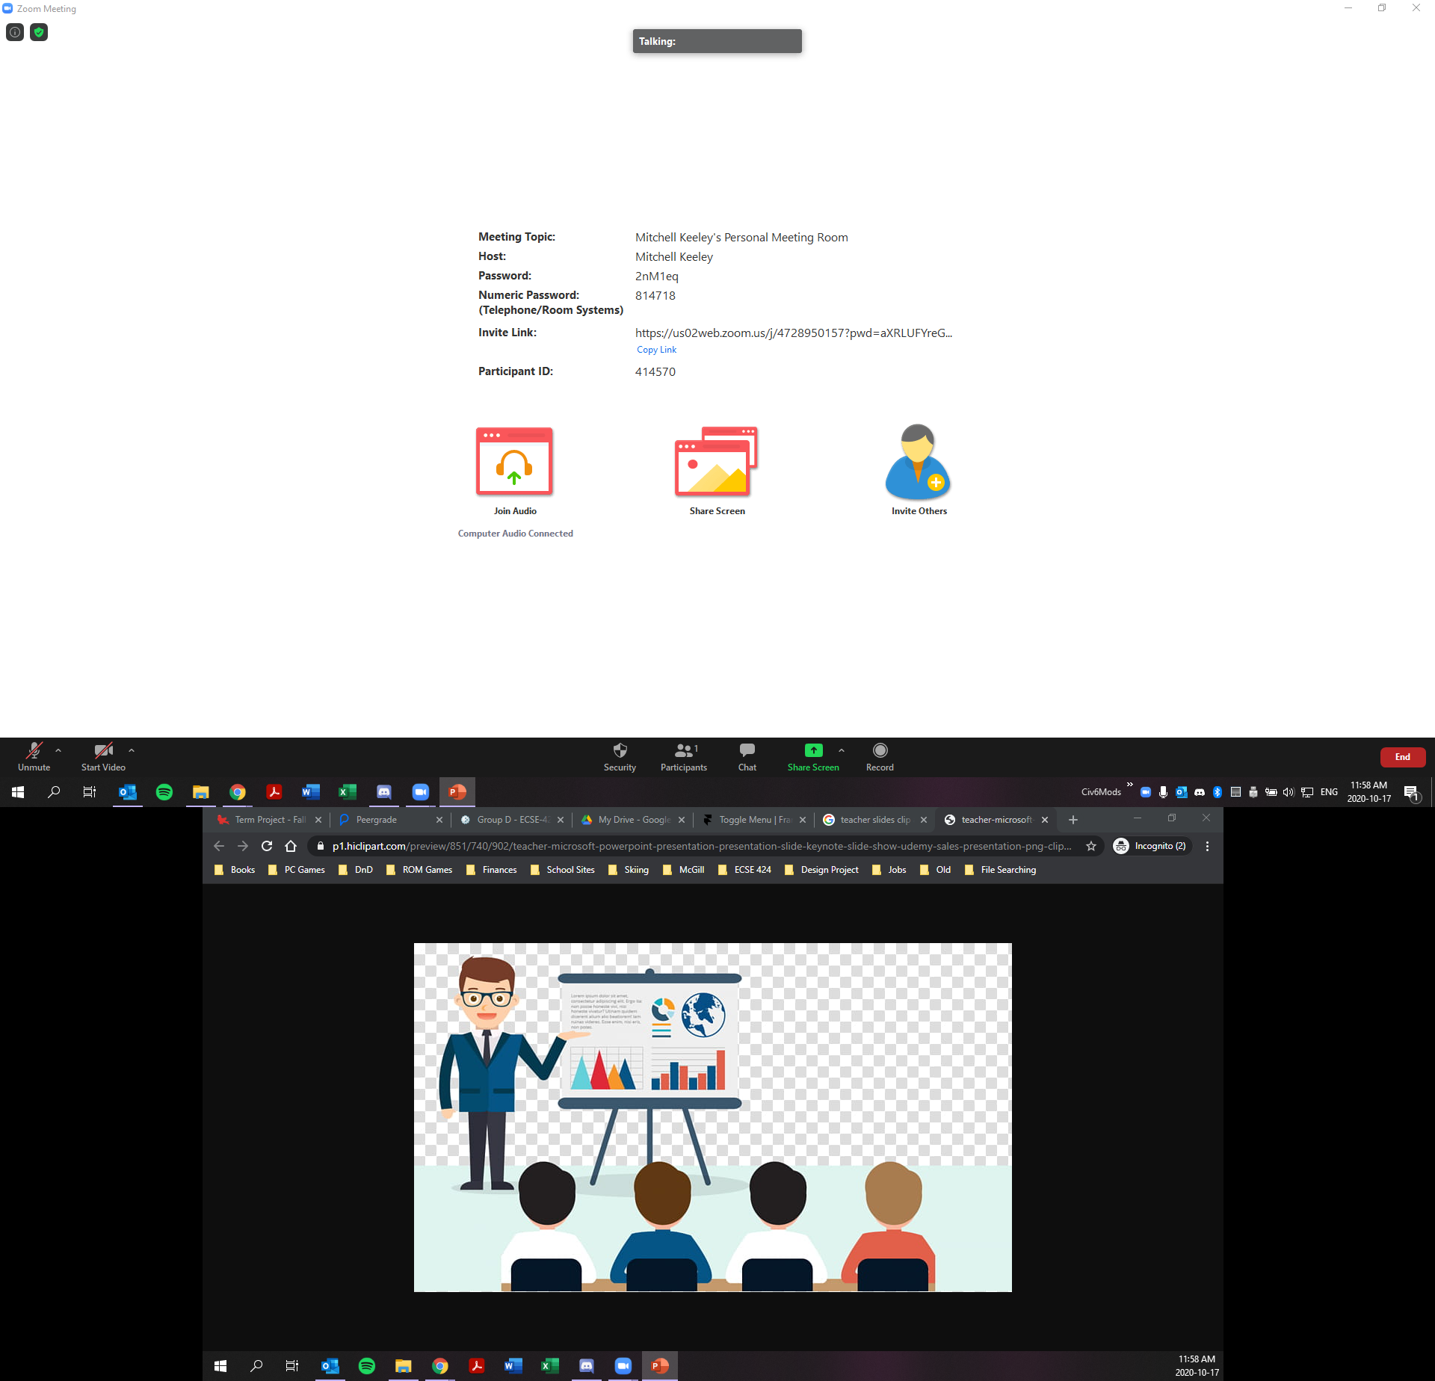



?
Question
Pending
Emoji
Question
Emoji
Question

Slide 3



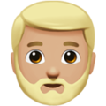




Attentive

Slide 4
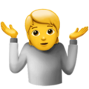
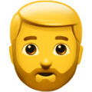
Confused

Slide 5
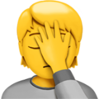
Bored

Slide 6

Question

Slide 7
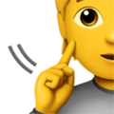
Louder

Slide 8

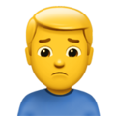
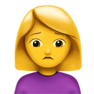
Stressed/Unhappy

Slide 9
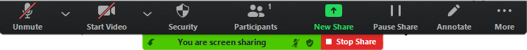
Attentive:
24
Unhappy:
6
Question:
3
Bored:
8

Slide 10
(Dismiss)
An attendee is now confused 5 sec.
(Dismiss)
An attendee is now attentive 3 sec.
(Snooze)
An attendee has a question !!!

Slide 11
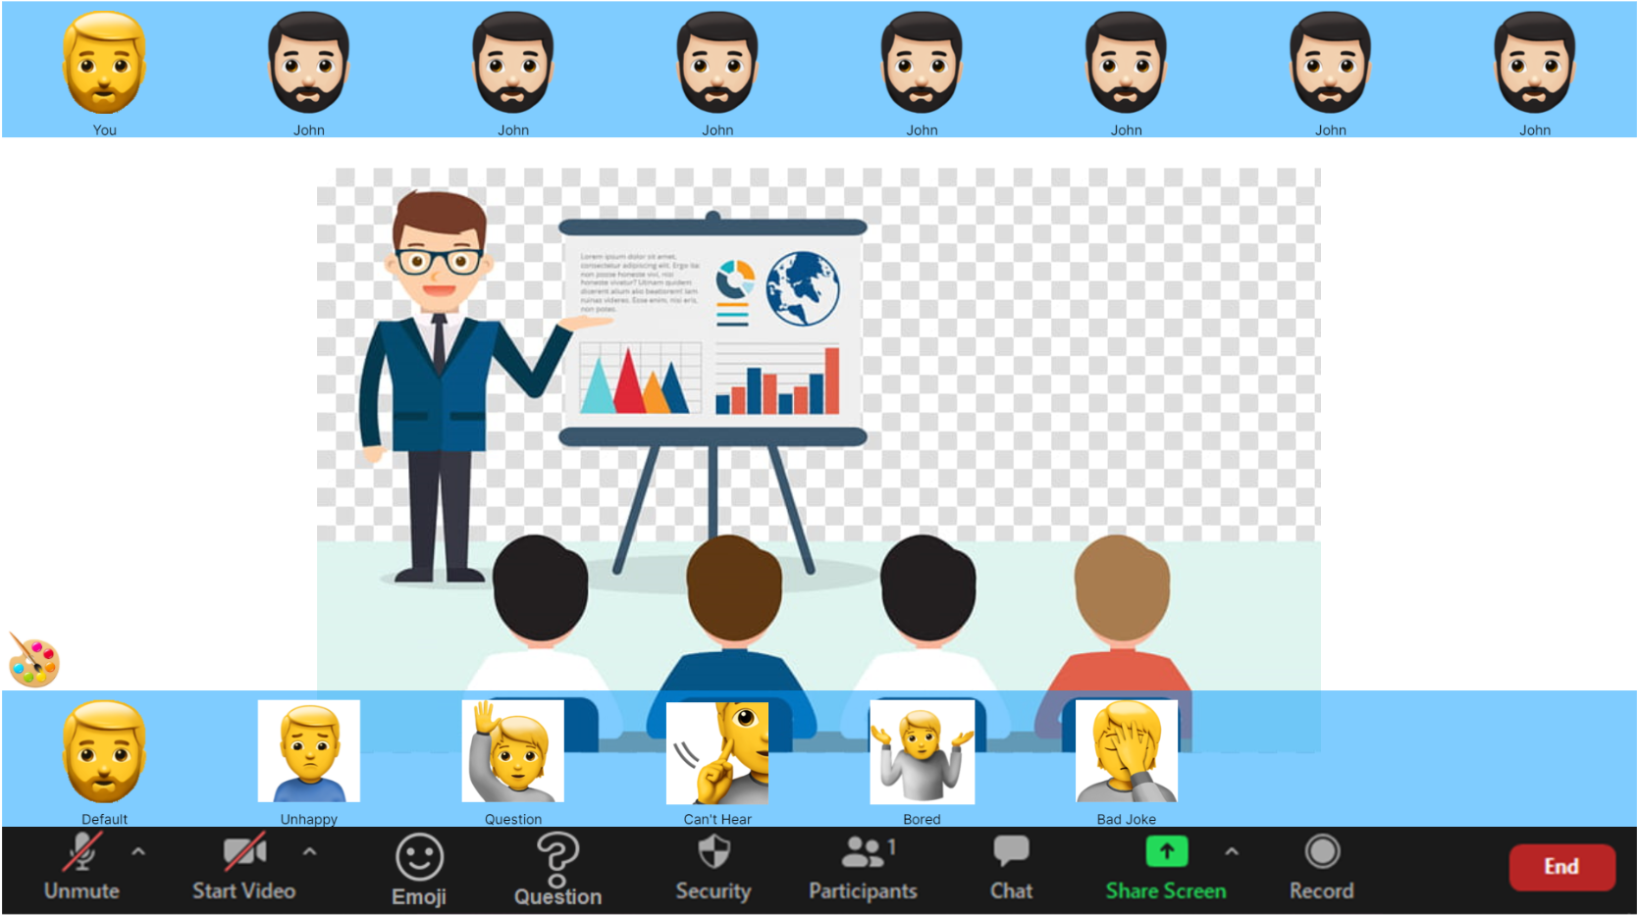
3.
2.
1.

Slide 12
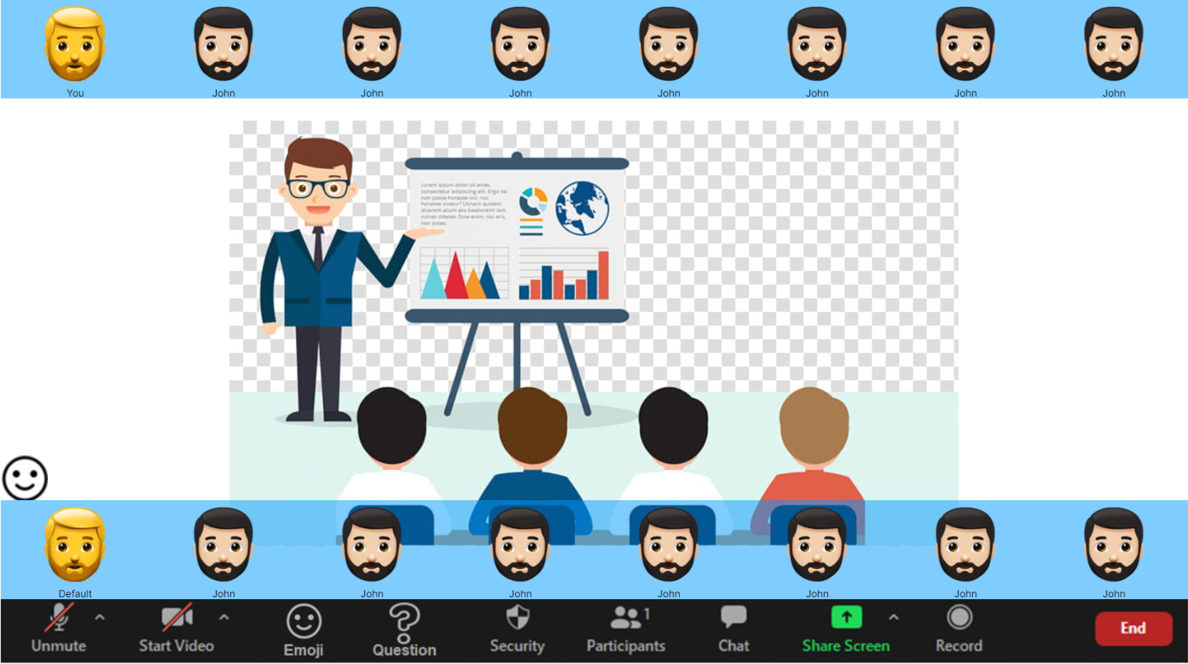
1.

Slide 13
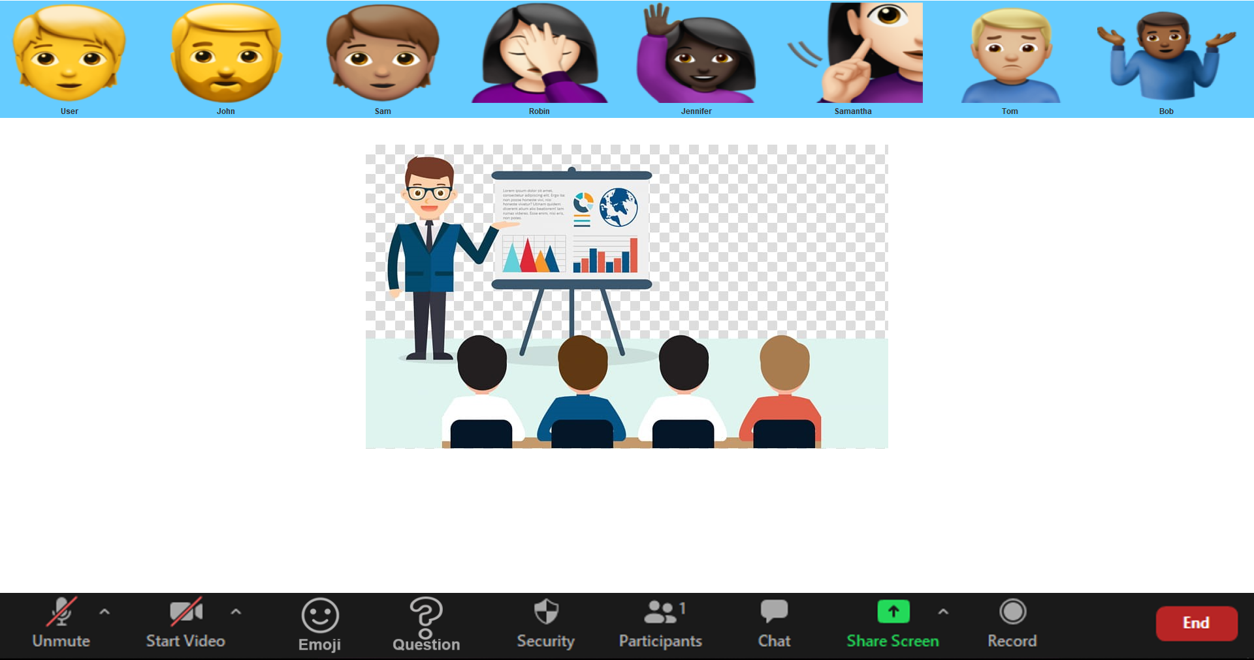
1.

Slide 14
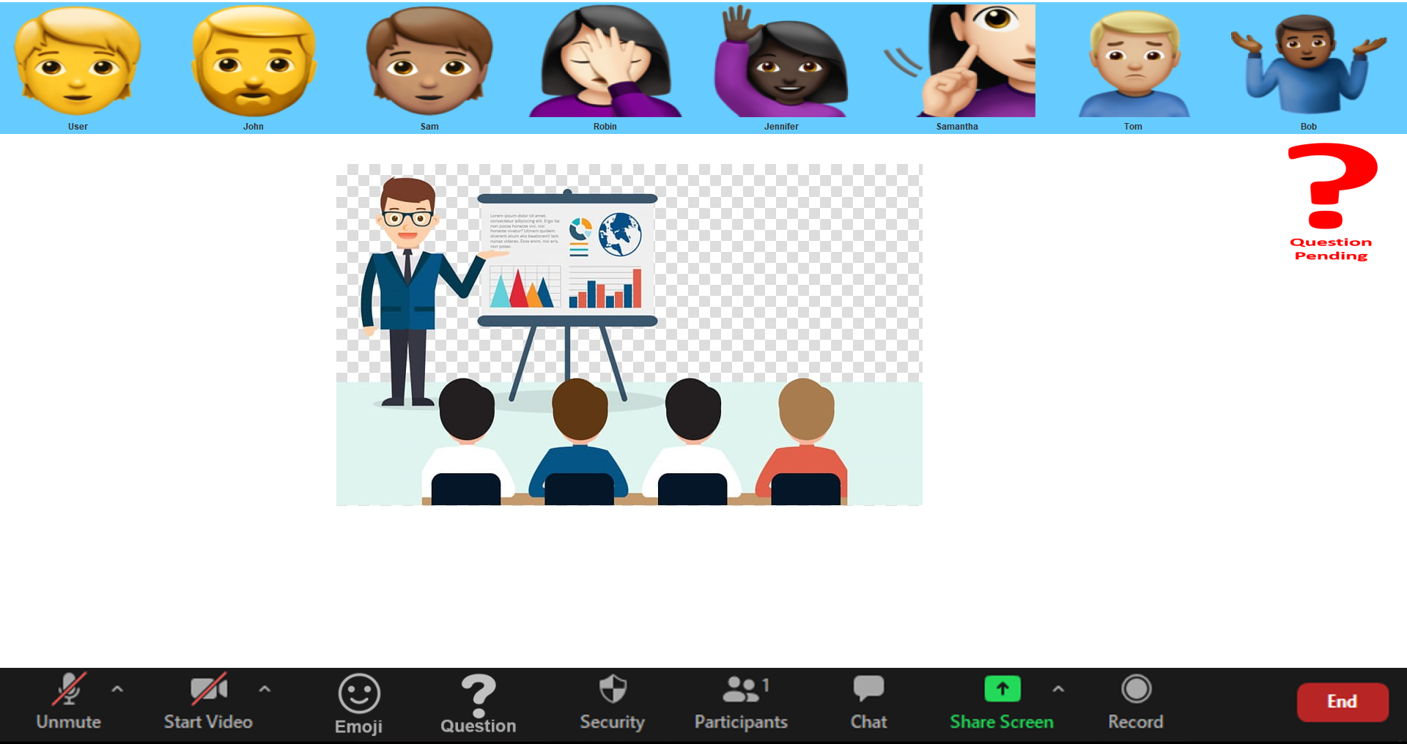
1.

Slide 15
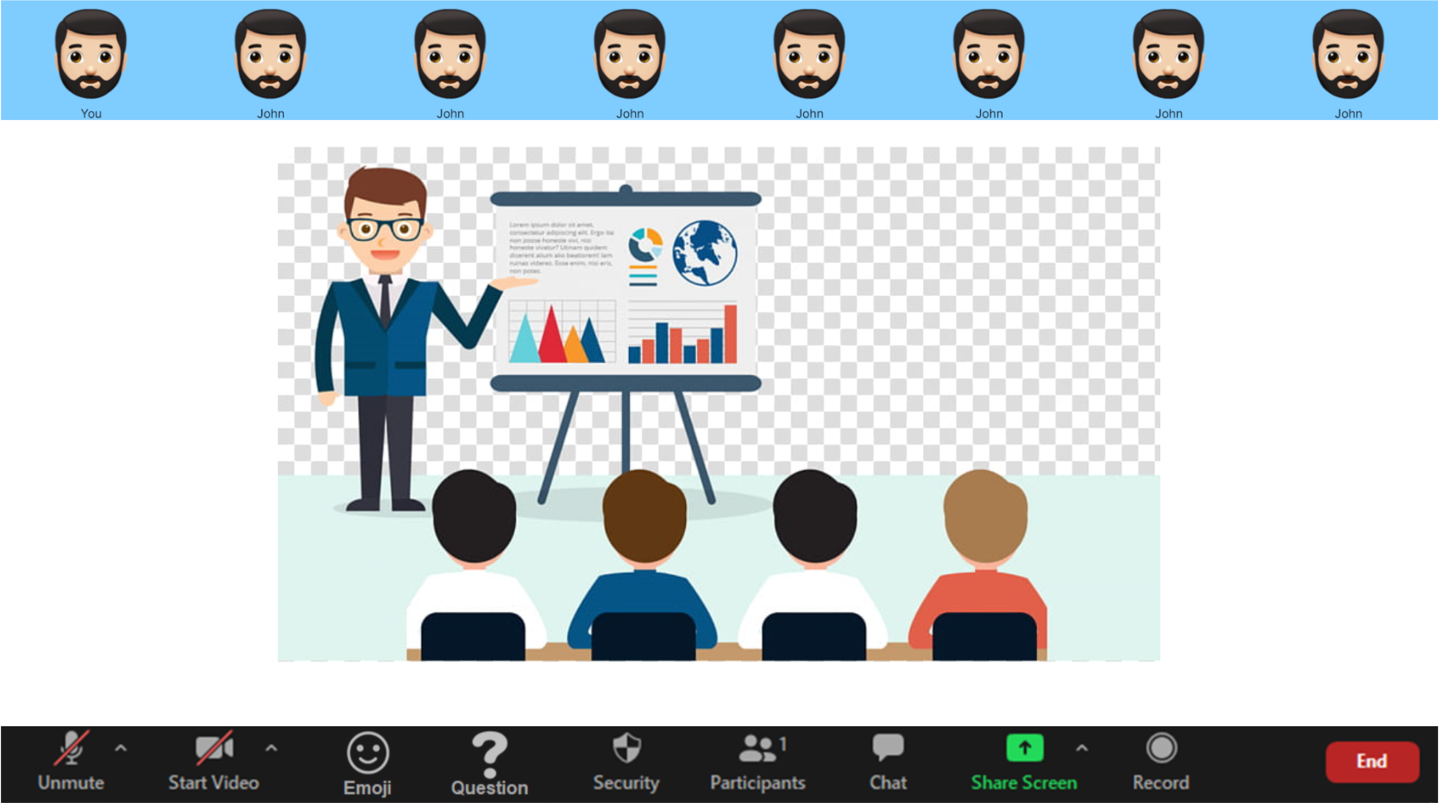
1.

Slide 16
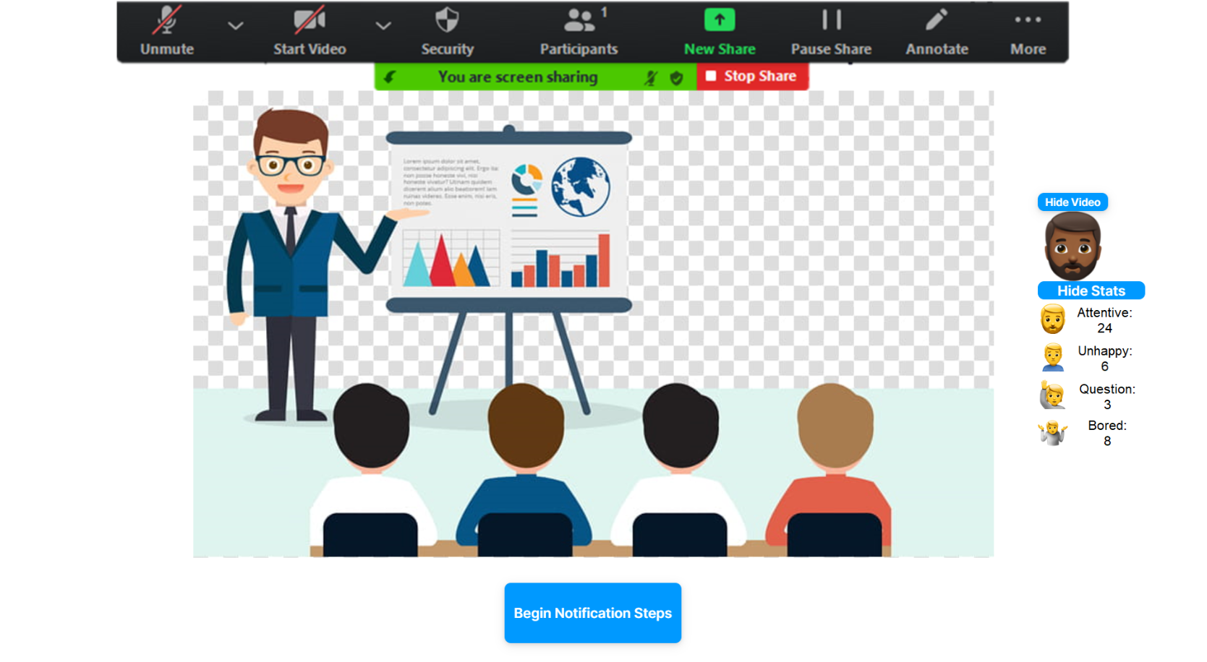
1.

Slide 17
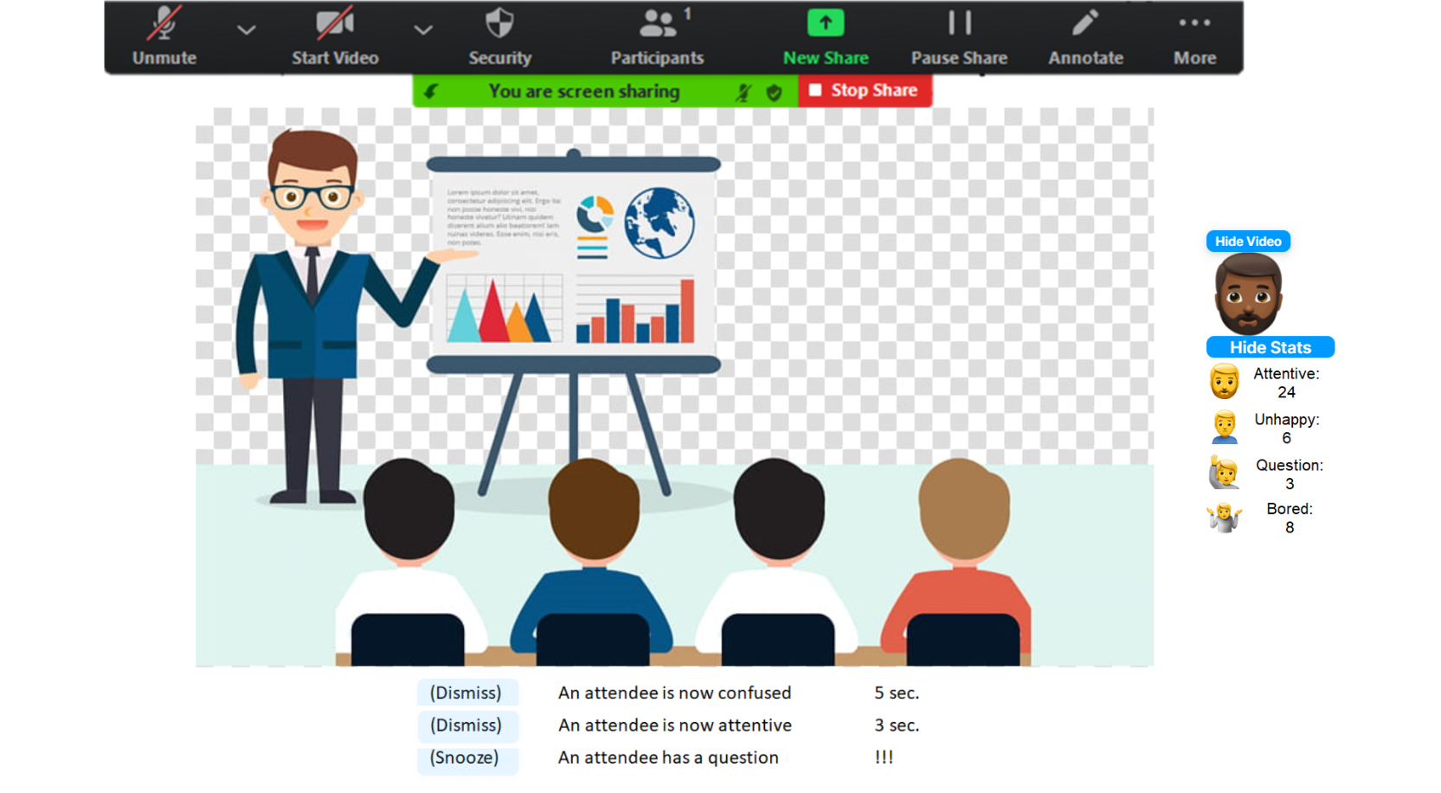
1.
2.
3.

Slide 18


Slide 19
